Slide 1
Tea Time Traditions
Denise G. Dias
Johnson Co. Extension Agent
Family & Consumer Sciences

Slide 2
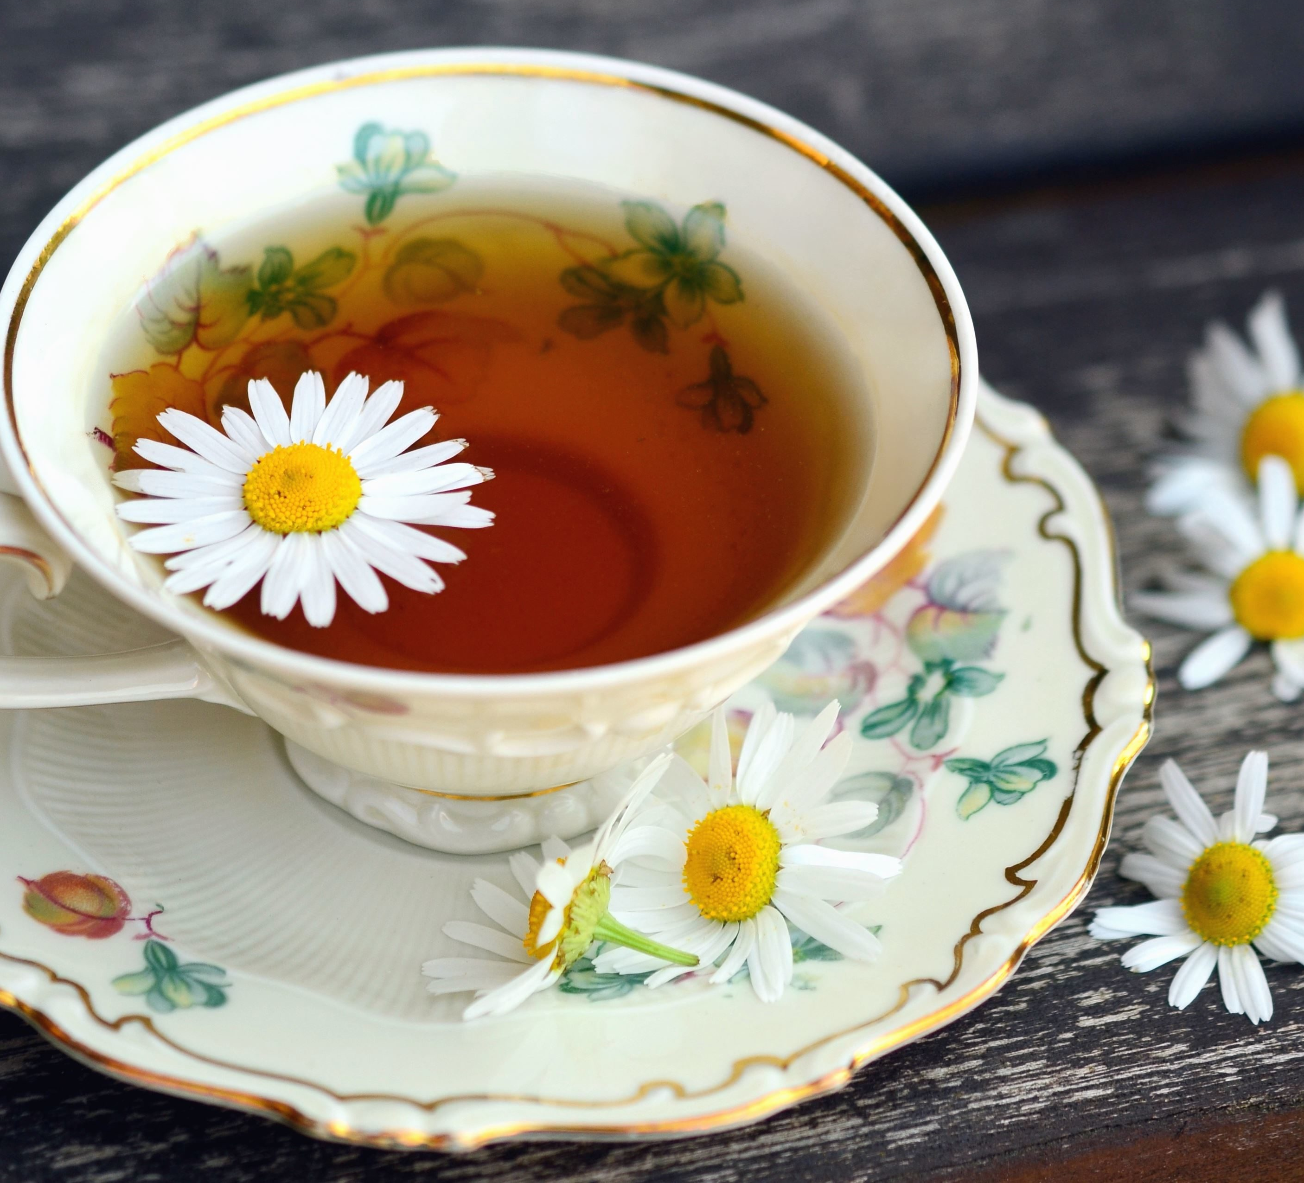
What is your favorite memory of Tea?
We will go around the room and Denise will call on you one by one

Slide 3
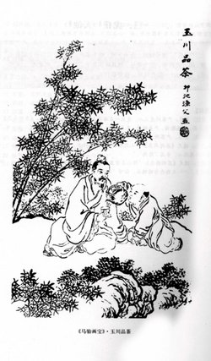
Tea Steeped in History
2737 B.C. - Tea leaves fell into a pot of boiling water
Chinese Emperor Shen Nung drank it,
thought it was healthy Gave one “vigor of body, contentment of mind and determination of purpose”
Mysterious healing powers

Slide 4
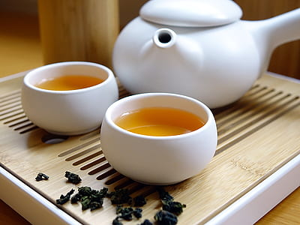
Value and prestige
Used as a bartering tool for trading goods
Popular social custom among China’s elite
White tea was once revered as the rarest and most delicate of teas

Slide 5
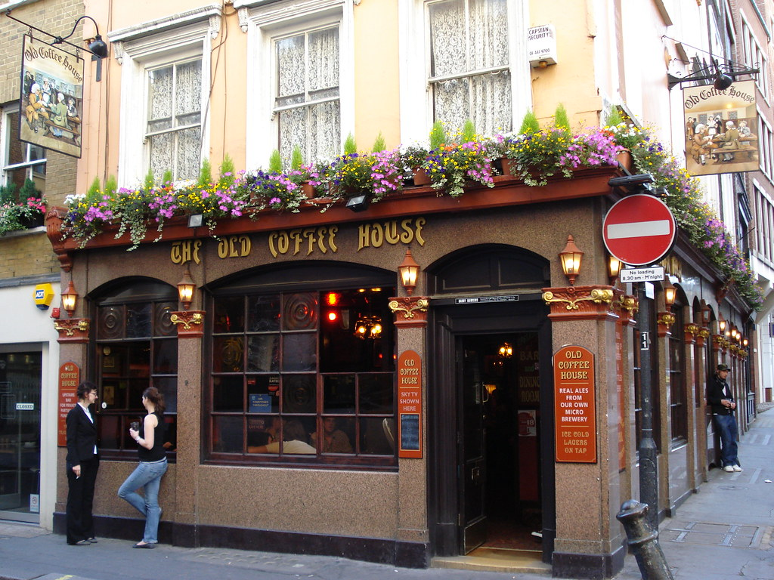
English Choose Coffee (& Tea) Houses over Taverns and Pubs
More popular than alcoholic beverages
Britain lost revenue on liquor sales
Queen Catherine was a huge tea drinker and set the example for British subjects to indulge in the new fashionable drink.
This Photo by Unknown Author is licensed under CC BY-SA-NC

Slide 6
British Taxes Americans Tea…
Tax was designed to save the British East India Tea Company
Colonists paid 3 pence/lb. taxes on 2 million pounds of tea
The Sons of Liberty attempted to block the tea from entering in our harbors in New York and Philadelphia. Georgians kept it in a damp warehouse rendering it useless.

Slide 7
Boston Tea Party
Boston Son’s of Liberty decided to make a statement. Disguised as Native American Indians the emptied 342 chests of tea into the harbor. The British legislated the “Intolerable Acts”. This led to the First Continental Congress which was a precursor to the Revolutionary War.
This Photo by Unknown Author is licensed under CC BY

Slide 8
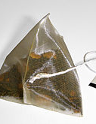
Iced Tea & Tea Bags
In 1904 at the Louisiana Purchase Exposition in St. Louis, Missouri, Iced tea was created. The weather was hot and no one was interested in tea, until they poured it over ice cubes.
It became the Exposition’s most popular beverage.
Simultaneously, Thomas Sullivan sent out silk bags of tea samples for customers to try instead of in a tin. Viola! tea bags were born!
Iced tea accounts for 75-80% of all of America’s tea consumption.
65% of American Tea is packaged in a tea bag.

Slide 9
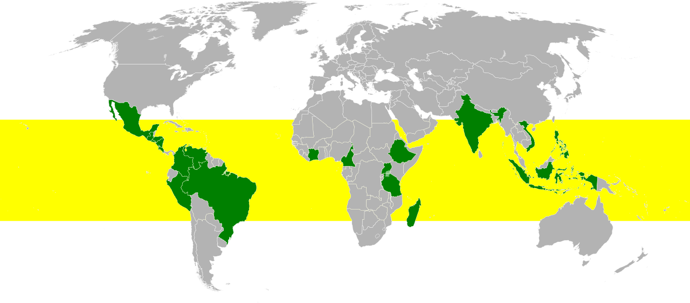
Tea is Grown Worldwide
3000 variations
Most widely consumed beverage world wide
Historic and Cultural importance

Slide 10
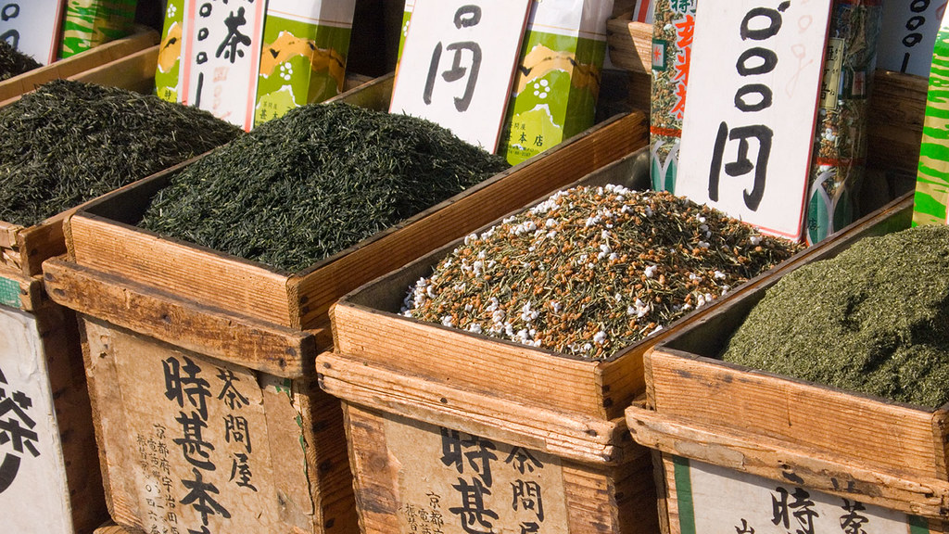
The Tea Market
Black Tea – 90% in US – fully oxidized and fermented
Green Tea – not oxidized, reduces cancer risk
Oolong Tea – partly oxidized a cross between black and green tea
White Tea – dried, not processed at all - delicate color and taste
Flavored Teas – flavor added to the tea (Earl Grey-bergamot oil)
Herbal Teas – Not from tea leaves. Berries, flowers peels, seeds and other plant leaves.

Slide 11
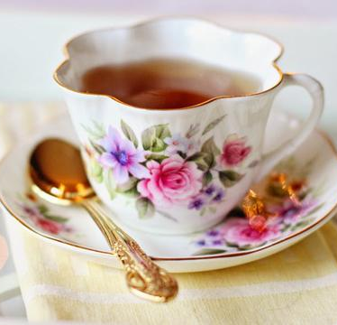
Consumption of Tea
Half the population drinks tea daily
Americans drink 80% of their tea over ice
Ready to drink teas have gained popularity in recent years

Slide 12
Nutrition & Health Qualities
Contains no sodium, fat, carbonation, sugar and is virtually calorie free
Tea contains tannins which are know antioxidants and protectors against cancer initiation and promotion.
Green tea offers the most protection
Black & Green teas may keep LDL Cholesterol from binding to the artery walls lowering the risk of heart disease
Reduces Plaque formation on teeth
Helps people to increase water intake

Slide 13
More Health Qualities to Note…
Tea contains fluoride and can strengthen tooth enamel which helps to prevent tooth decay and loss
Tea can stain and discolor teethe
Is a diuretic and increases urination
The tannins in tea prevent iron absorption in the body. Consider your entire diet when deciding to eliminate foods from it. When in doubt talk to a dietician.

Slide 14
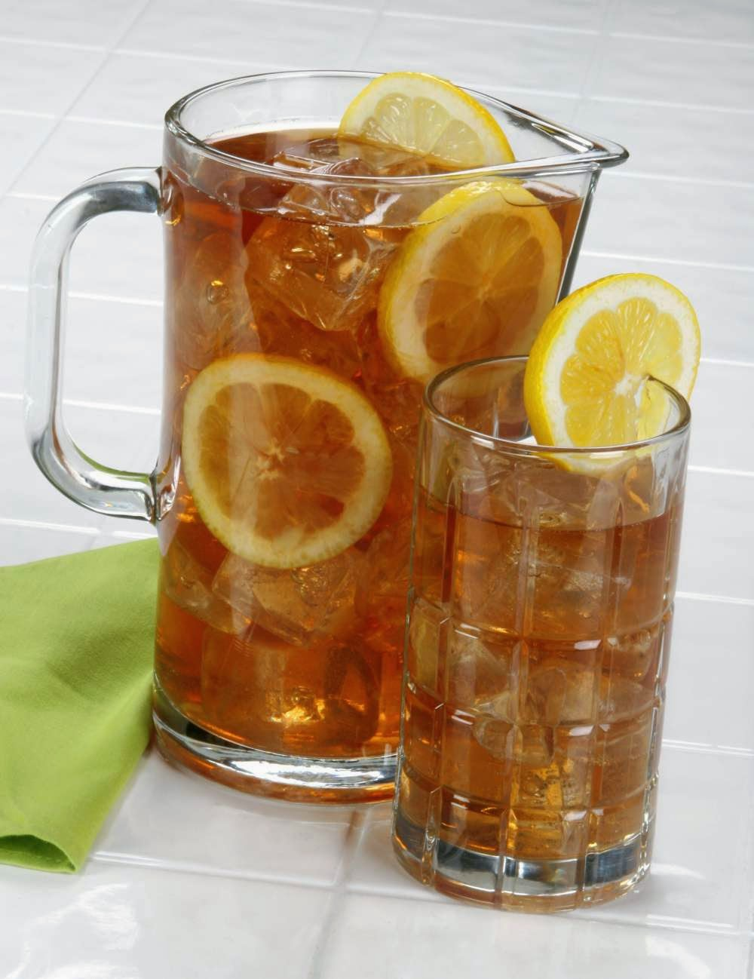
Making Iced Tea
Recommendations for Iced Tea Safety
* Iced tea should be brewed at 195 F for 3-5 minutes.
* Iced tea should be stored for no longer than 8 hours.
* The tea brewer, storage dispenser, and faucet should be cleaned daily.
The CDC stated that redesigning tea dispensers to be more easily dismantled and cleaned could further reduce the theoretical risk of bacterial contamination of iced tea.
Sun Tea
According to the CDC, “The practice of making ‘sun tea’ by steeping tea bags in a container of water in the sun may be higher theoretical risk than brewing tea at higher temperatures because it provides an environment where bacteria are more likely to survive and multiply.

Slide 15
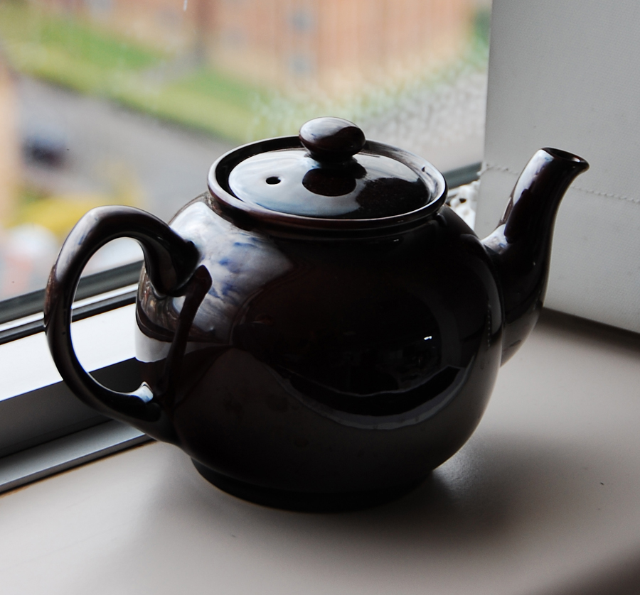
Perfect Pot of tea
Always start with fresh cold water
Brew in a clean glass, pottery or china tea pot
Warm the tea pot with warm water before adding in the boiling water or tea leaves
1 ½ teaspoons of loose tea per cup of water
Brew from 3-5 minutes, remove tea leaves (bitter)
Green and Oolong teas take 2-3 minutes to brew

Slide 16
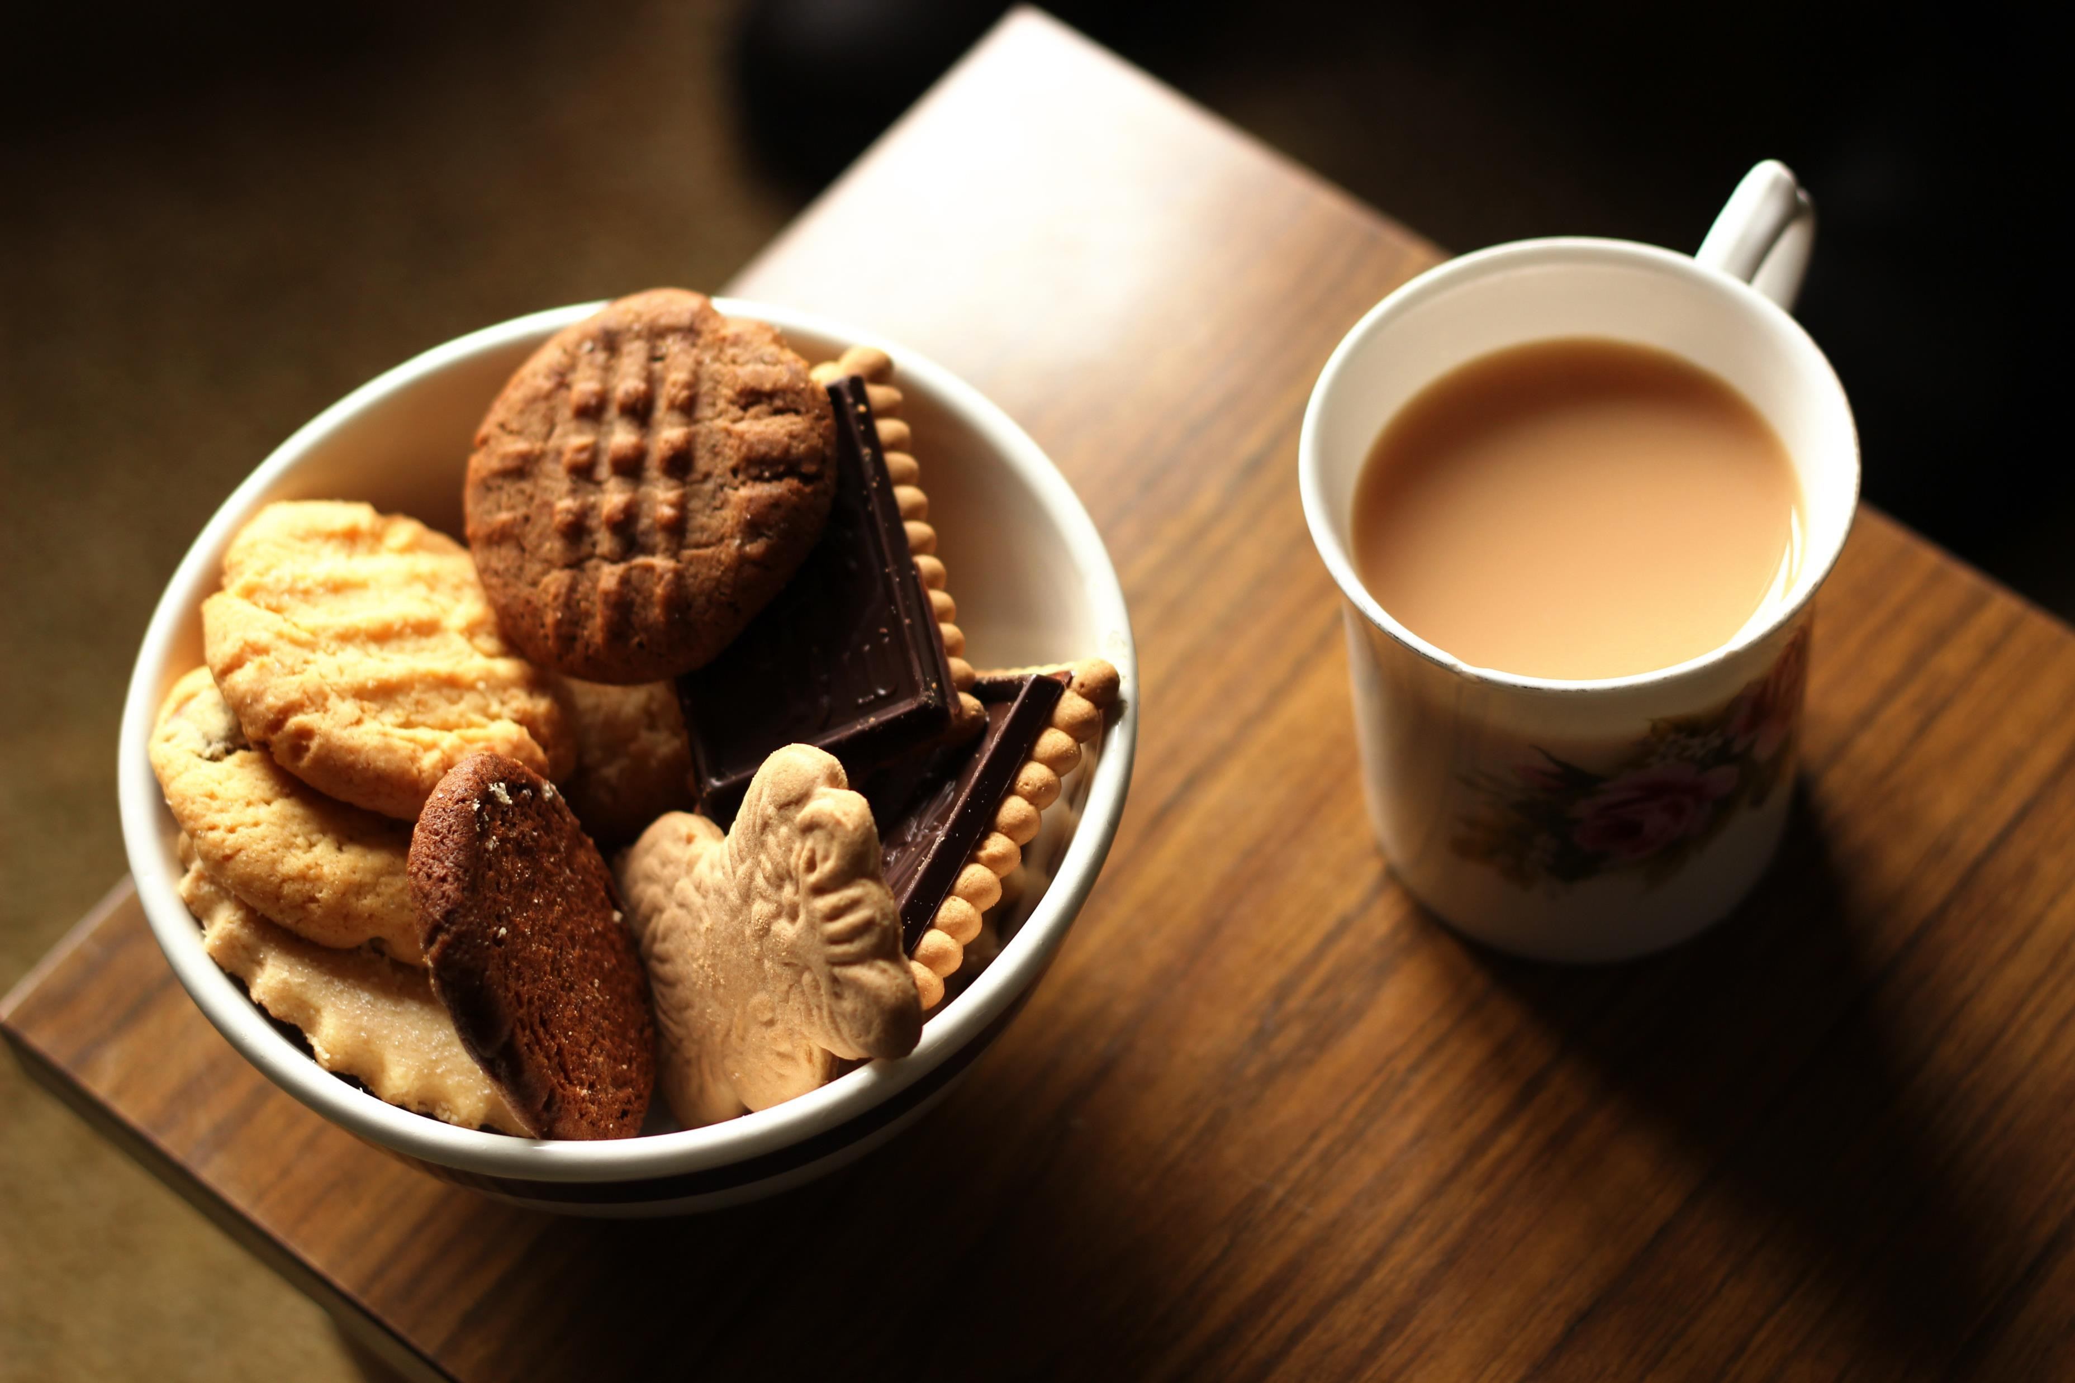
Elevenses
British tradition of stopping mid morning for a cup of tea and a light snack
Crackers spread with cream cheese and jam
Bran or fruit muffins
Fruit juice

Slide 17
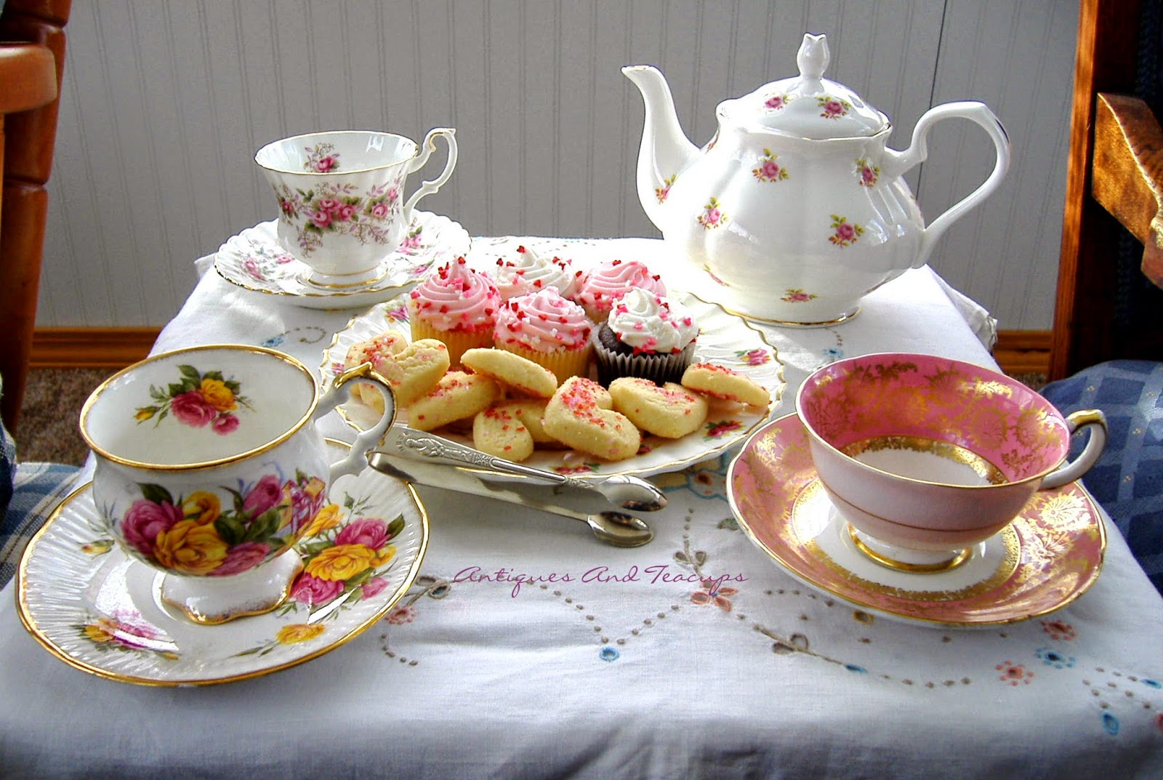
Afternoon Tea
Inspired by Anna. Duchess if Bedford in mid 18th century (3 - 4 pm)
Set the scene
Cloth napkins, tablecloths, lace table runners
Silverware, porcelain or glass plates, cups and saucers do not need to match, trays platters and cake stands for tea time snacks.
Flowers are always a nice touch, bring the outdoors in
Something sweet, something savory, fresh baked scones, petit fours, open faced sandwiches

Slide 18
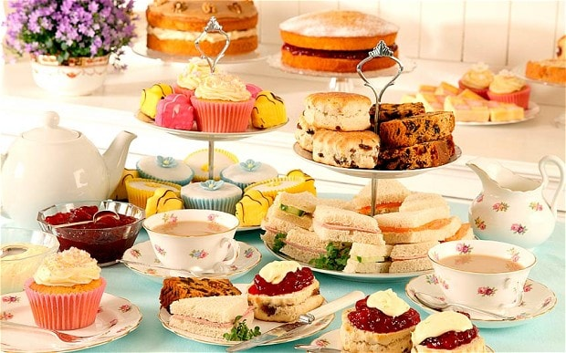
High Tea Dessert Tea
Substantial evening meal between 5 - 6pm
Buffet of savory pies, hearty sandwiches and sweet desserts
Tray at the end of a meal
Variety of flavored teas
Fresh fruit, cinnamon sticks and yogurt or sorbet
Fruit punch, seasonal juices or fruits and mints

Slide 19
Caring for your Tea Things
Tablecloths and napkins can be soaked with an oxygen bleach product and washed as usual. Avoid using chlorine bleach as it can destroy the fabrics
Clean silver with white toothpaste OR line a sink with aluminum foil hot water and 1 cup of TIDE(no substitutes) OR a plastic tub with foil, baking soda, salt and boiling water. CLEAN well after using any of these methods so your silver does not become pitted.
Clean the inside of a teapot with salt and water paste OR a small amount of chlorine bleach – rinse very well.

Slide 20
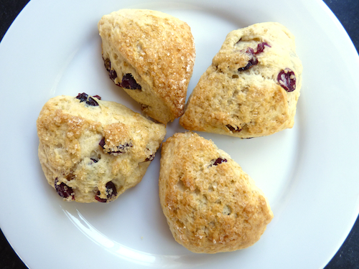
Recipes for your next Tea…
Spiced Tea Mix
Almond Chicken Tea Sandwiches
English Cucumber Tea Sandwiches
Pumpkin Taco Dip
Cream Scones
Devonshire Cream
Lemon Curd
Heavenly meringue Tarts
Apple-Pecan Tartlets
Bit Sized Sticky Buns
Butter Cookies
Pumpkin Scones
Cranberry Bruschetta

Slide 21
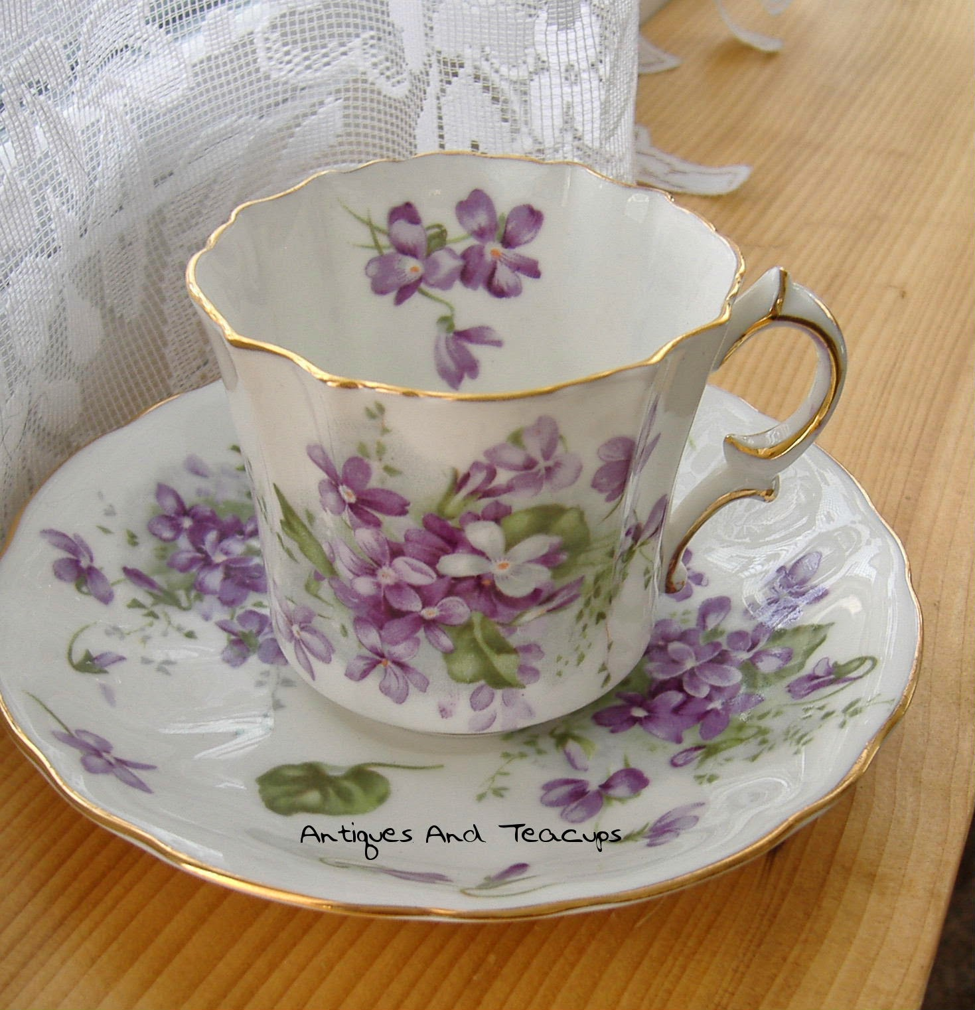
Questions or comments?
Tea Handout, Recipes and PowerPoint Slides are available on the Johnson County Website under the Home and Family tab, FCE
Send Feedback to denise.dias@jocogov.org
Thank You!
Denise Dias, M.S.
Johnson County Extension Agent, FCS
913-715-7000
www.johnson.k-state.edu

