Slide 1
Colored Pencils & Crayons on Fabric

Slide 2
Supplies for Colored Pencils and Crayons
Fat Quarter 18” x 22” 100% cotton white or off white or a preprinted black and white fabric (other options are noted later)
Pellon SF101
Colored Pencils
Fabric medium
Small paint brushes
Paper towels
Baby wipes
Crayons colors and white crayons

Slide 3
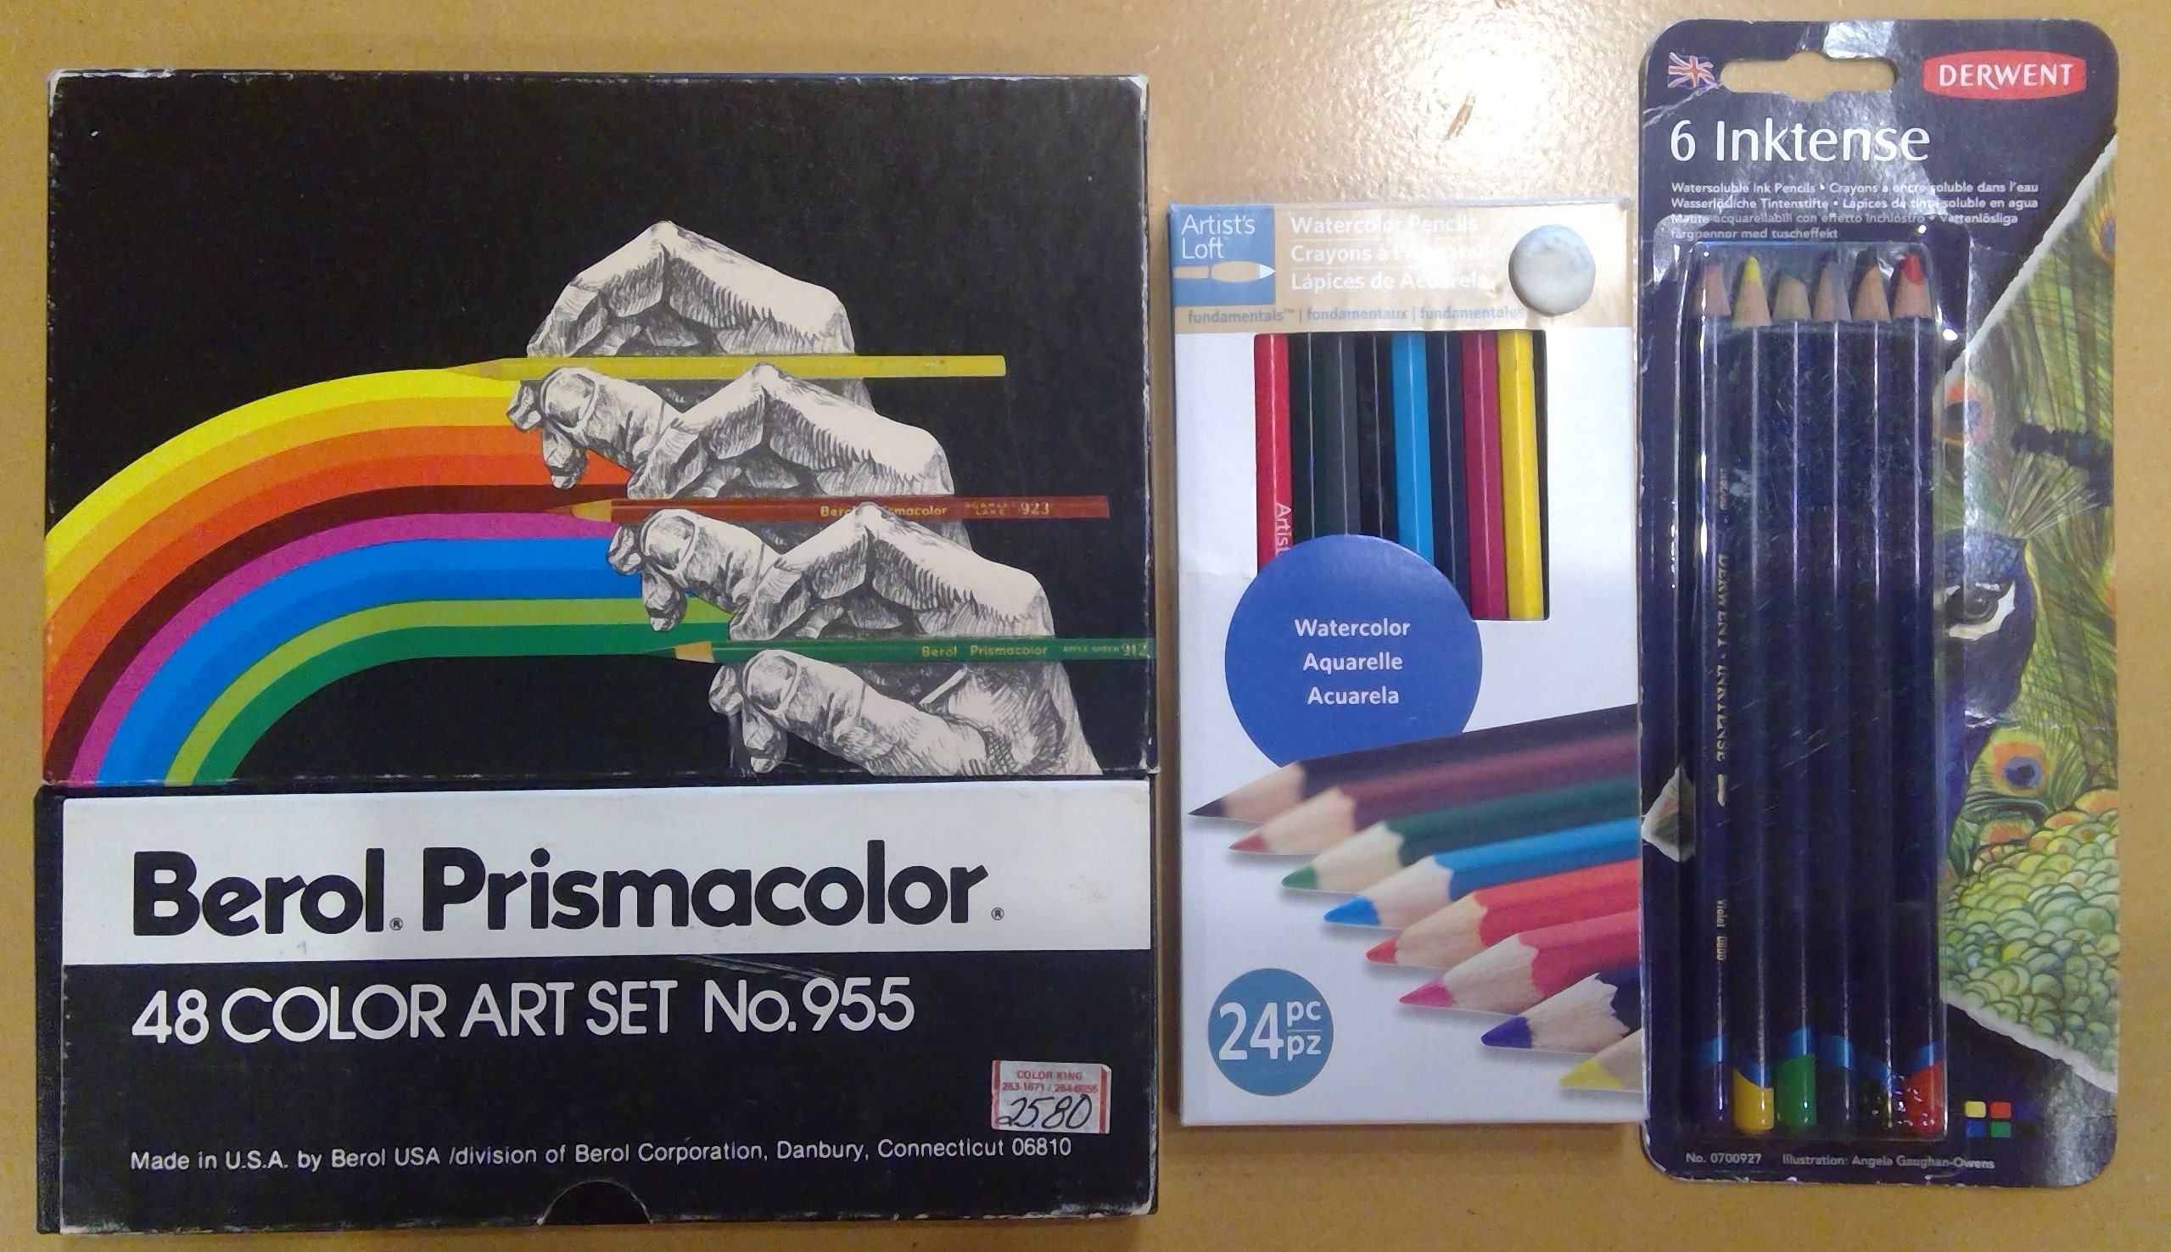
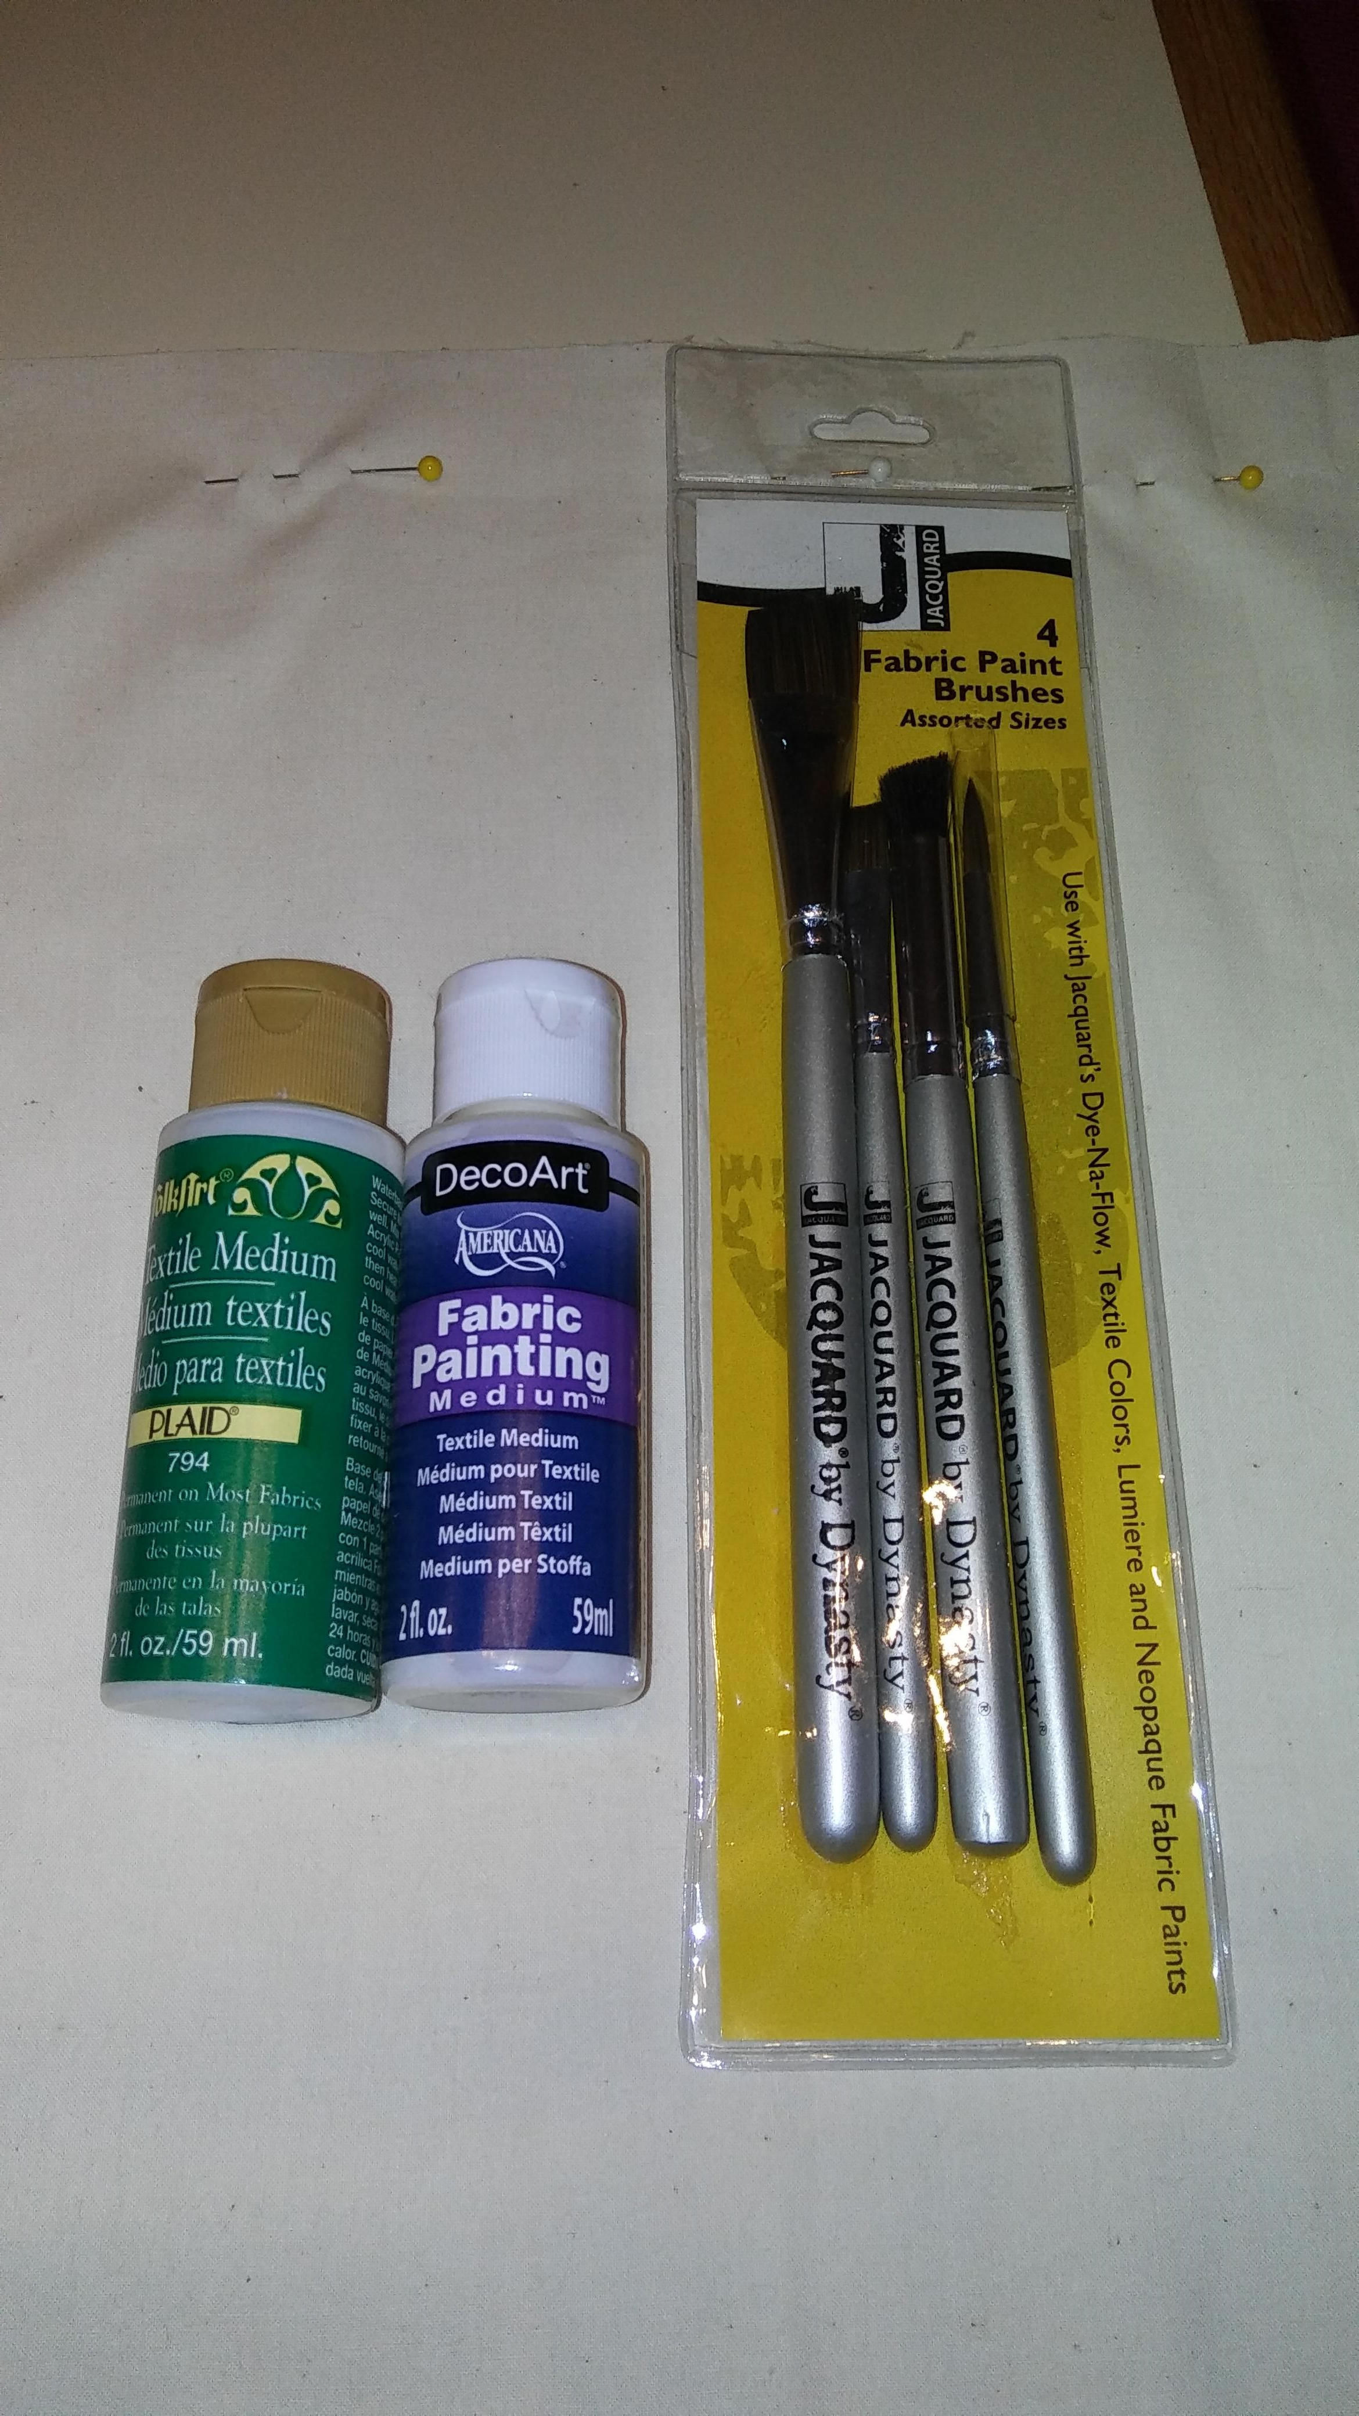
Materials needed for coloring with Colored Pencil

Slide 4
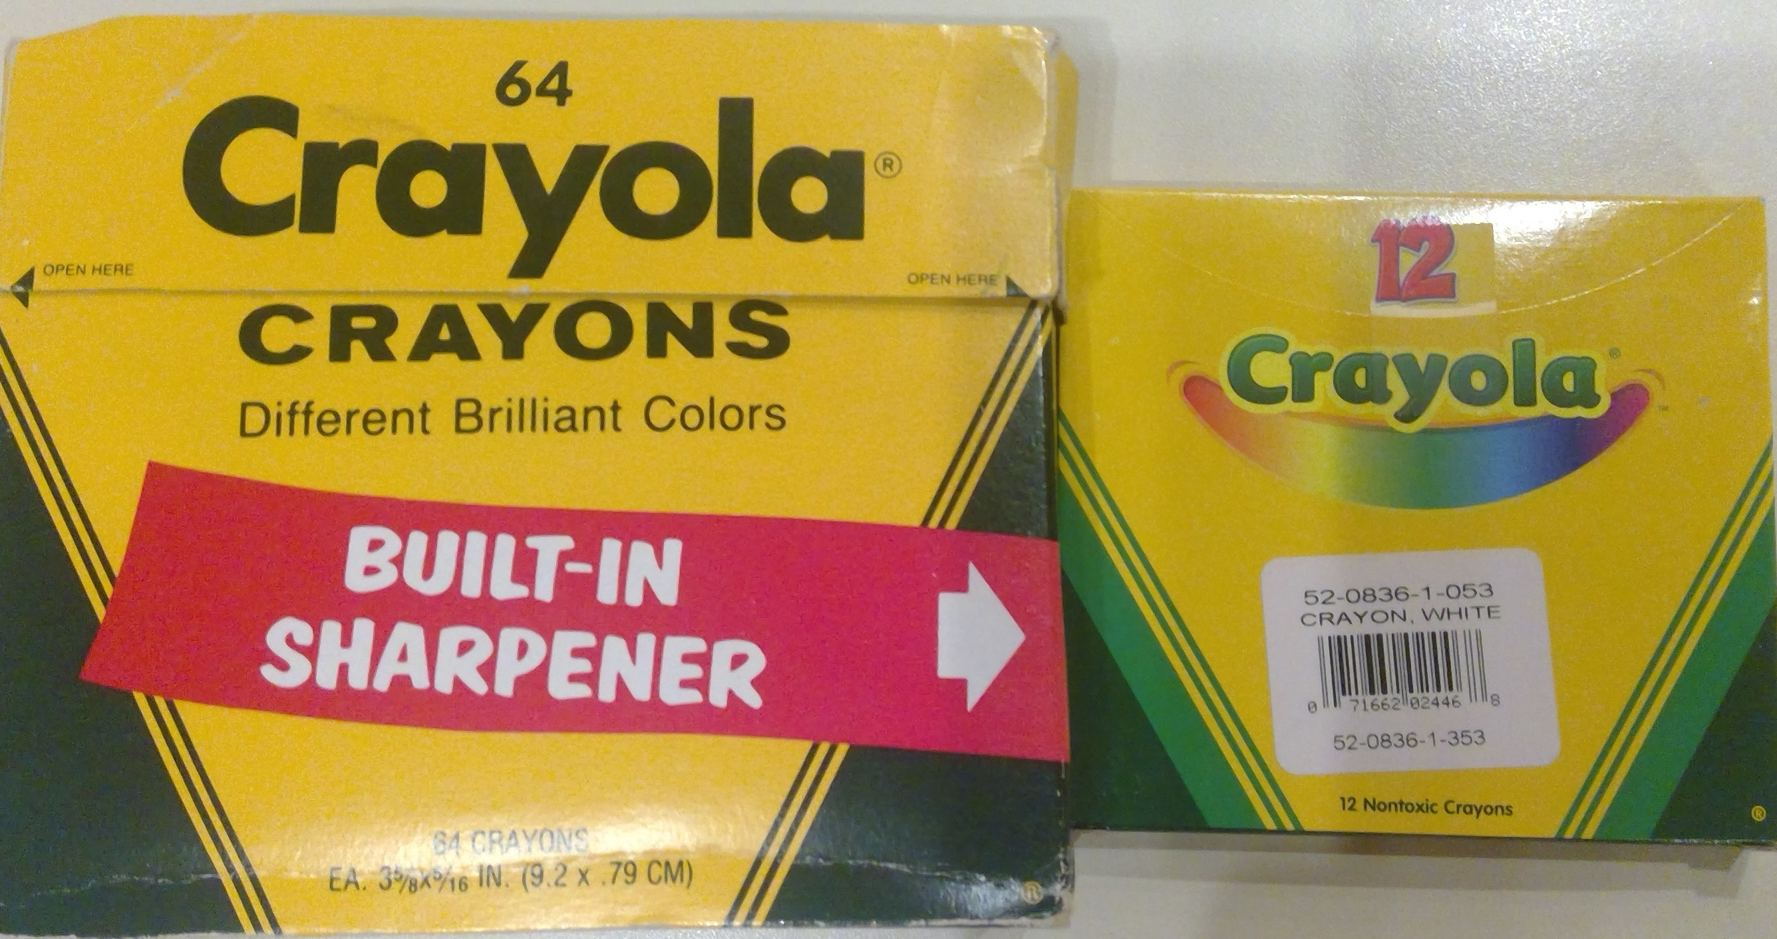
Materials for Crayons You can use the same fabric options for crayons

Slide 5
Options for fabric to color
Trace a drawing of your choice
Preprinted design on commercial fabric
Open machine embroidered design
Draw your design on the fabric
Free motion stitched design

Slide 6
Traced picture from commercial pattern

Slide 7
Preprinted and Open Embroidery Designs to Color

Slide 8
Additional open embroidery design

Slide 9
Hand drawn design ready for free motion quilting

Slide 10
Free motion design ready to color

Slide 11
Options for preparing fabric
Draw your design on the fabric, layer and complete free motion for your design. It can be a pieced fabric
Design is traced, embroidered and stabilized
Stabilize commercial fabric with preprinted designs

Slide 12
Coloring with colored pencils
Coloring can be done dry or wet for colored pencils
Do not use water it will cause your colors to fade and bleed. Use fabric medium
If you color dry, you will add the fabric medium after you finish coloring each section
The fabric medium will turn your colors brighter
You can blend colors wet or dry, and you should start with your lightest color first if blending colors
Fabric medium can be painted on the fabric, or you can dip your pencil in the medium
Be careful to NOT use too much fabric medium

Slide 13
Coloring with Crayons
No fabric medium is used as the base for crayons
Color all areas with white crayons first (this is your base to replace fabric medium)
Add your colors by starting with your lightest color if you are blending colors

Slide 14
Finishing with colored pencils
Continue to color and blend your colors to complete your project
Heat set your project using the following options
Iron with a hot iron covering your project with a thin pressing cloth
Throw your project in a hot dryer for 20 minutes.

Slide 15
Finishing with crayons
Cover your colored piece with a white paper towel and iron with a hot iron.
This will melt the wax out of your piece into the paper towel and heat set your color.
Continue to iron until you no longer get color on your paper towel, changing towels as needed.

Slide 16
Finished Examples
Colored pencils and crayons

Slide 17
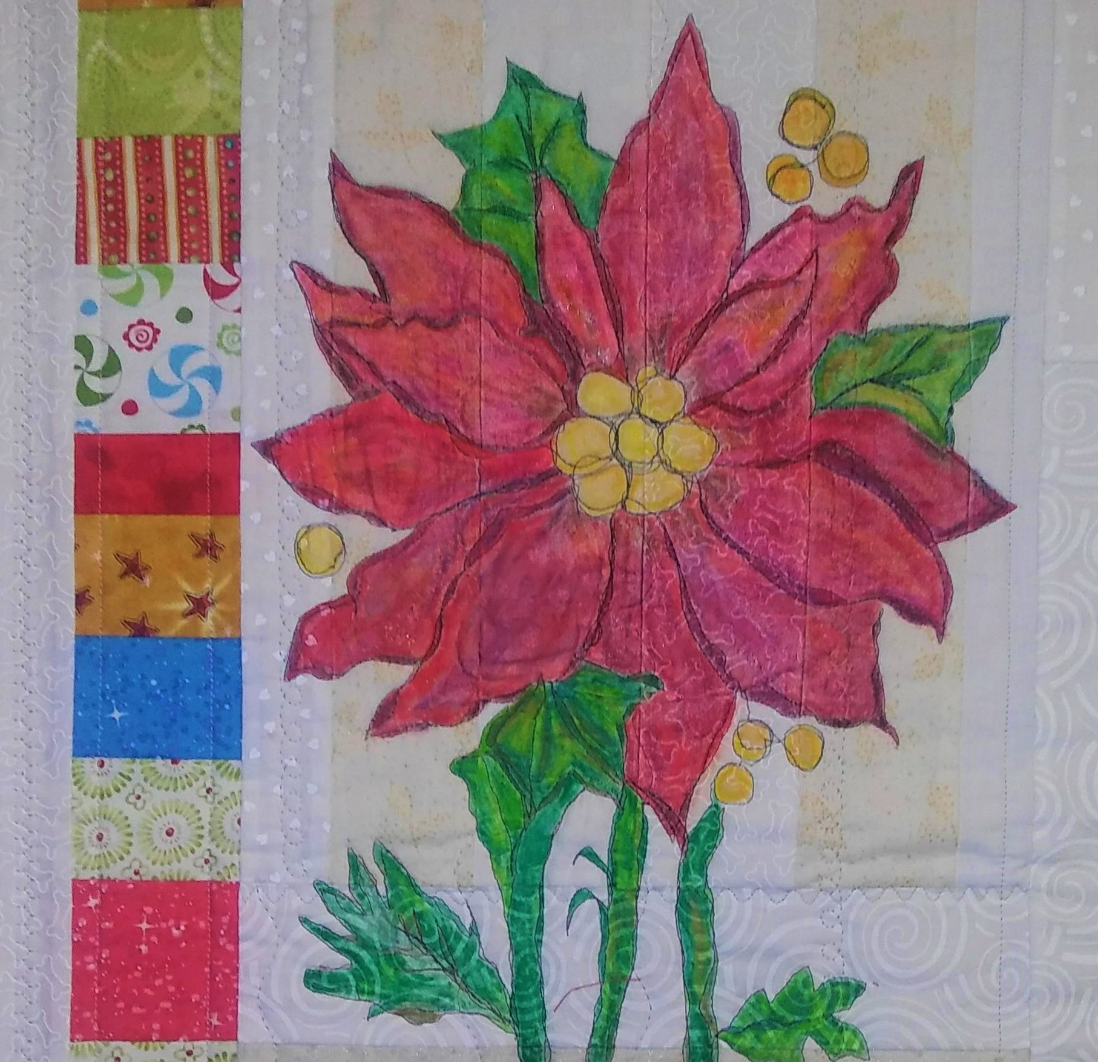
Free motion design and colored pencils on a pieced background colored after it was quilted

Slide 18
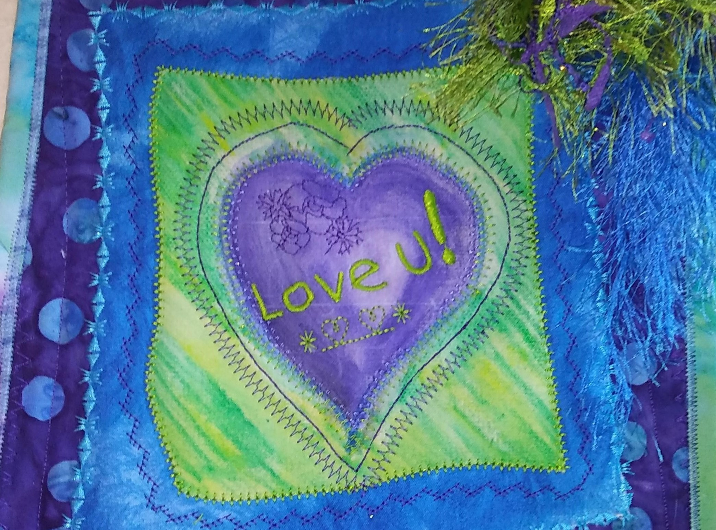
Free motion design with colored pencils, decorative stitches and embroidered alphabet

Slide 19
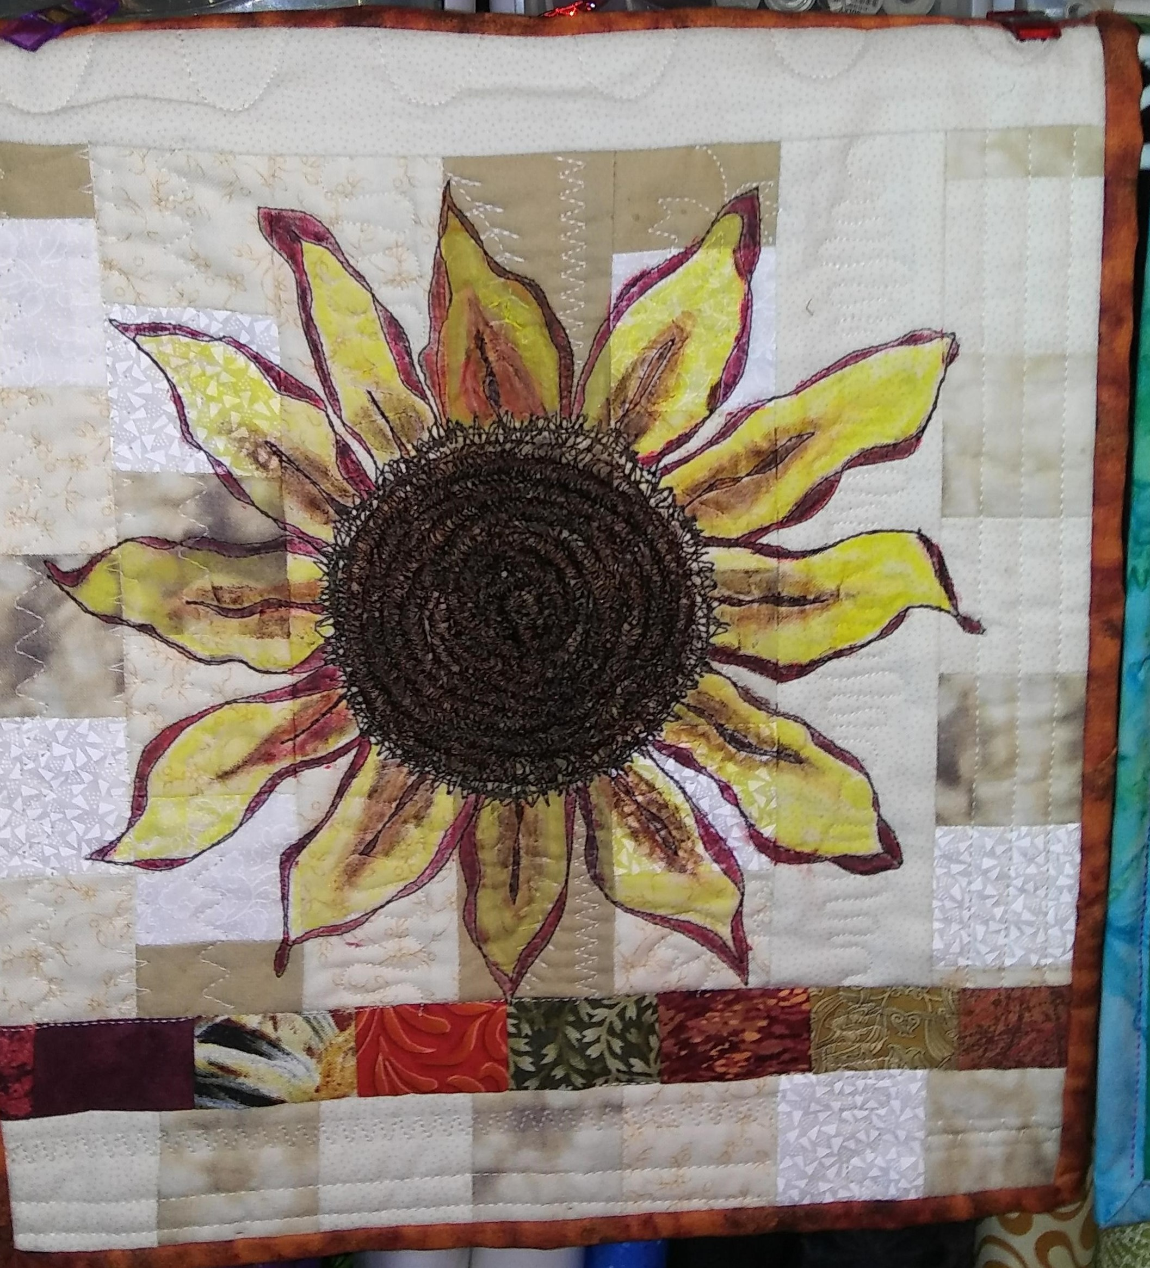
Pieced, prequilted, free motion design with colored pencils & thread painting

Slide 20
Artist Loft Pencils on preprinted design with hand embroidery

Slide 21
Colored with a variety of brands of colored pencils & hand embroidered after coloring on left

Slide 22
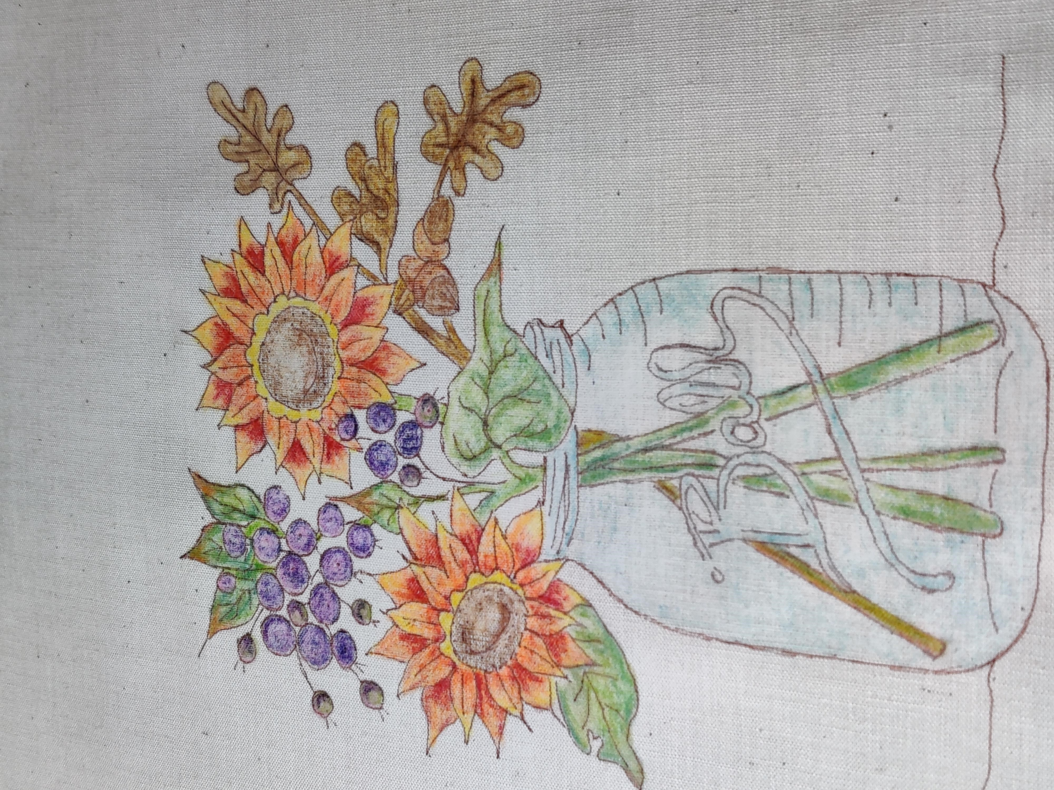
Crayons on traced commercial design with hand embroidery

Slide 23
Crayola Crayons colored on preprinted design after completing hand embroidery

Slide 24
Soy Crayons colored on preprinted design prior to embroidery

Slide 25
Crayola Crayons embroidered on preprinted design prior to coloring

Slide 26
Just a few Google Links for coloring on fabric
https://www.google.com/search?client=firefox-b-1-d&q=Coloring+on+fabric&sa=X&ved=2ahUKEwie7_qyo6rxAhXHGDQIHbw2DHgQ1QIwFHoECBgQAQ&biw=1500&bih=847&dpr=2
https://www.google.com/search?client=firefox-b-1-d&q=Coloring+on+fabric+with+crayons&sa=X&ved=2ahUKEwie7_qyo6rxAhXHGDQIHbw2DHgQ1QIwF3oECBsQAQ
https://www.amazon.com/Creative-Quilts-Your-Crayon-Box/dp/1604680806
https://www.craftsy.com/post/how-to-color-fabric-with-crayons/#

Slide 27
Questions
and
Discussion

